Slide 2
foster+freeman
FORENSIC SCIENCE INNOVATION

Slide 3
foster+freeman
FORENSIC SCIENCE INNOVATION
®
Fingerprints
Problem Solving

Slide 4
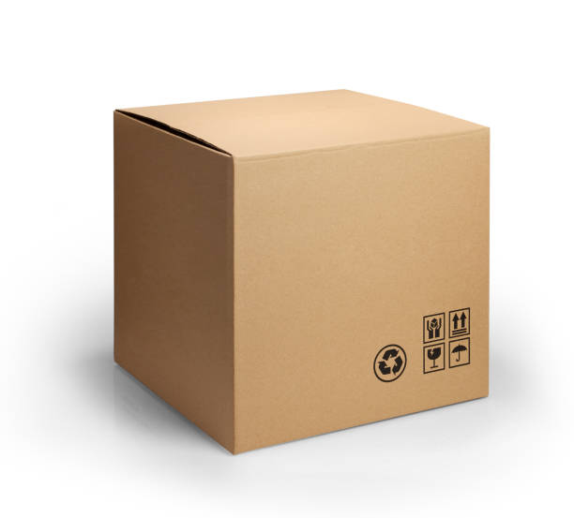
1994 – Examination tape/cardboard – Explosive Device
Small cardboard box received through the post.
Contained nails, explodes on opening.
Recipient not injured.
Paper/carboard adhesive tape received into the laboratory.
Address
Wiltshire
UK

Slide 5
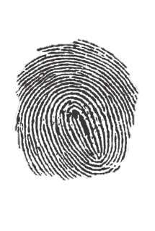
Visual Examination
Two fingerprints
Part covered in cardboard fibres
Part transparent – Part opaque
Difficult to photograph
Insufficient lighting tools.
Several days to obtain two photographs
Fingerprints identified to the recipient.
FSS statement: fingerprint left by whoever built the device.

Slide 6
Surface + Background light

Slide 7
Gentian Violet
Gentian Violet – adhesive dissolved – fingerprints deleted
Only Photographs remain
Arrest
Forensic Science Service (FSS) changed statement
Release
Compensation
Contentious for many years

Slide 8
Gentian Violet
Used on adhesive surface of tape.
Reacts with sebaceous fats.
Bristol police started using it on condoms used in drugs smuggling.
Experiment with latex gloves – changing the formula
Extra strong solution
No washing
Examine with backlighting
Digital Imaging

Slide 9
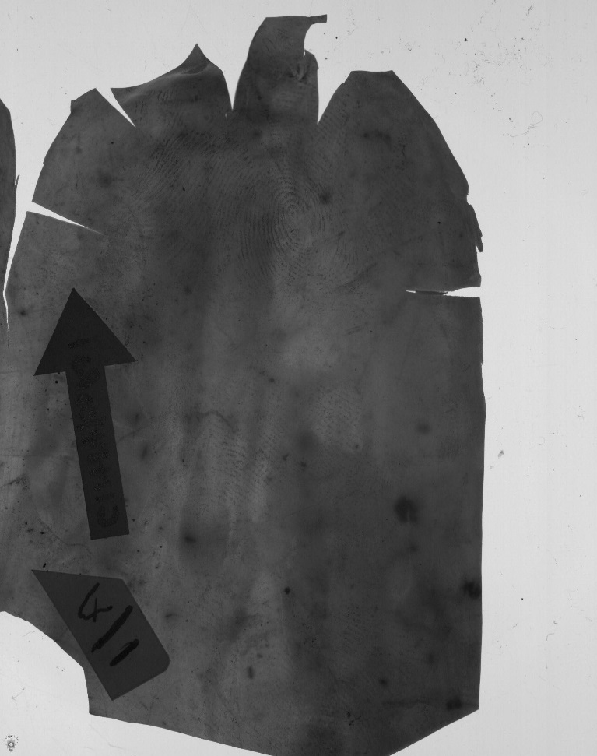
Gentian Violet – Latex Gloves
Strong GV - Backlighting

Slide 10
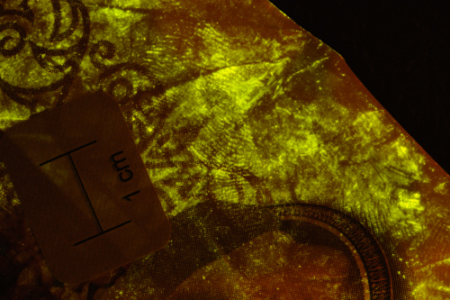
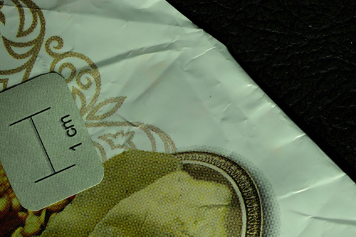
Fluorescence on Cyanoacrylate

Slide 11
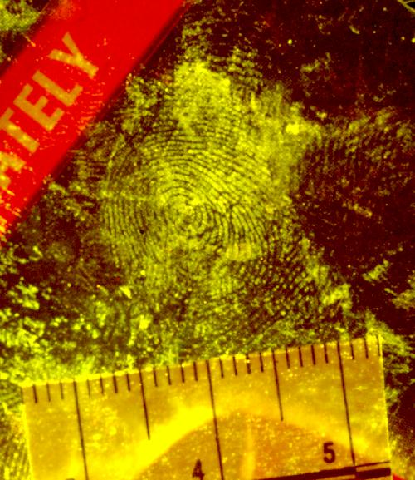
Fluorescence on Cyanoacrylate
Standard BY40 – Panacryl Brilliant Flavin 10ff in Alcohol(Ethanol) developed in 1985
Alcohol dissolves inks
Half water/half alcohol
Water only – poor results

Slide 12
Fluorescence Options
BY40
Black powders
Magna powders – blitz green – waxy papers
Basic red – surfaces fluoresce on the same wavelength as BY40
Basic red, plus BY40 give higher fluorescence
Sudan Black

Slide 13
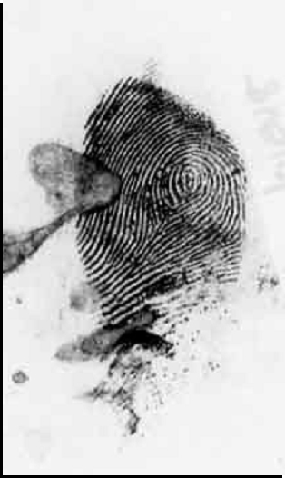
Thermal Papers – Fax paper/Receipts
Dimethylaminocinnameldehyde (DMAC)
Tested in against Ninhydrin – Visual process only.
Introduction of the FLS - Fluorescence
Dip sheets of A4 paper into the working solution and allow to dry.
Dry transfer process
Used first on Fax Paper

Slide 14
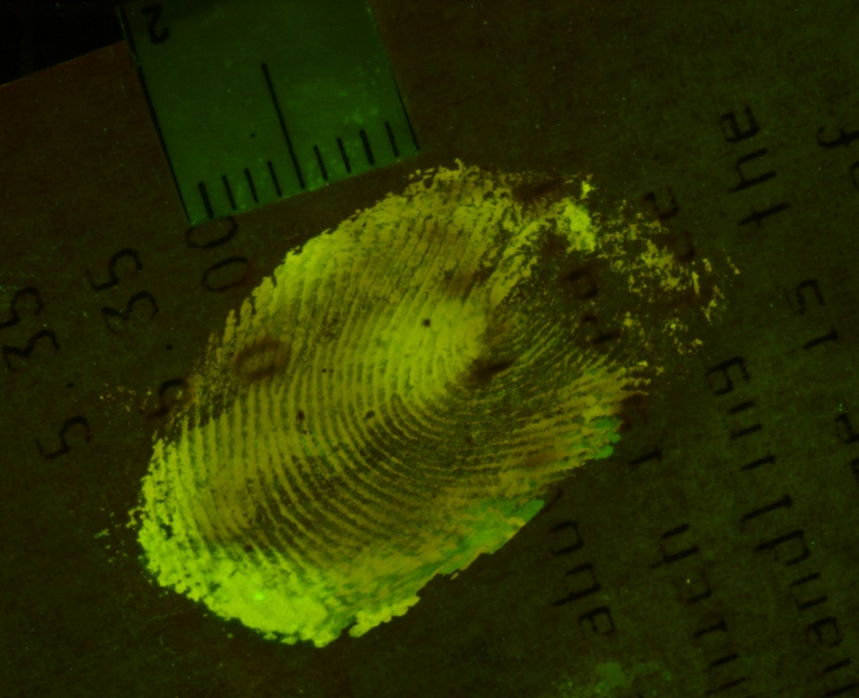
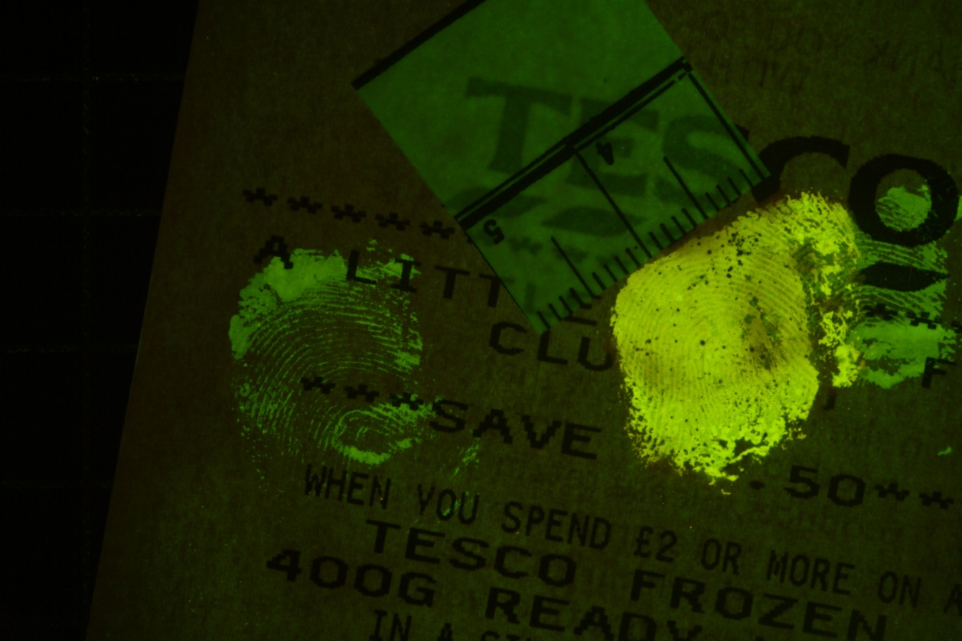
DMAC – Thermal Papers

Slide 15
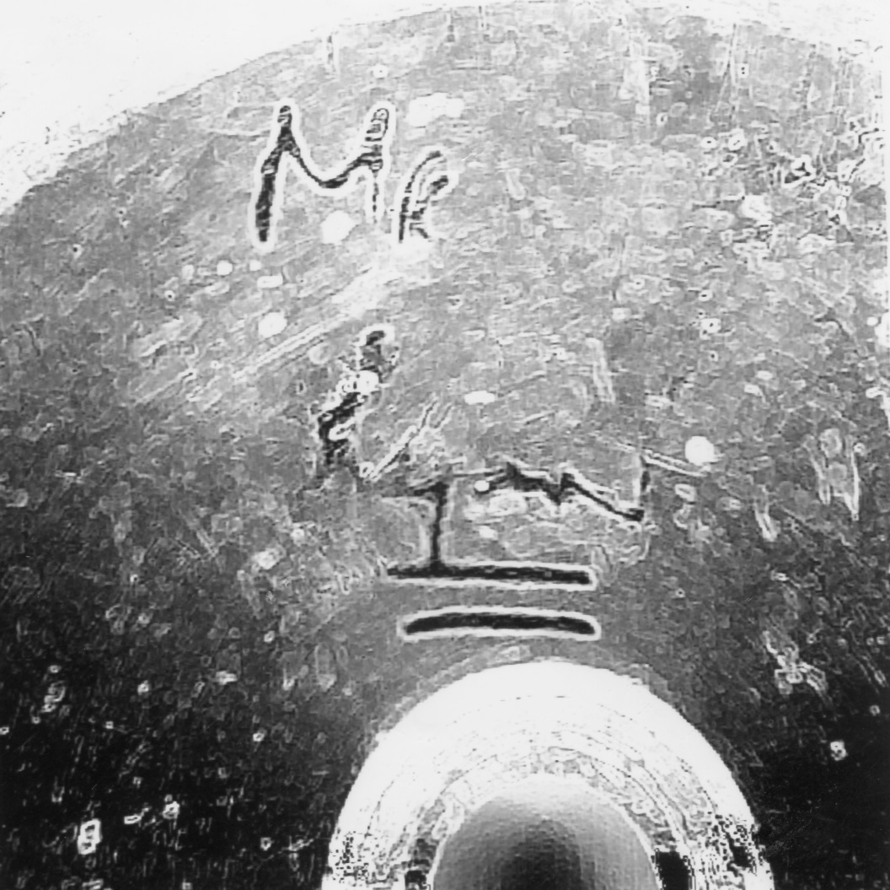
Cyanoacrylate – mid nineties
Digital Video capture
Free Medical Imaging software – scioncorp NIH Image – today called ImageJ.

Slide 16
Cyanoacrylate – mid nineties
Mr Ryan
£10 deposit held
Disc cutter hired from a shop, information led to the identity of the offender.

Slide 17
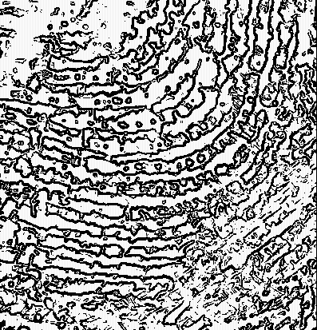
3rd Level/Forged Fingerprints
Highlight edge of ridges and pores
Forged fingerprints from rubber stamps
Notes:
Image filtering combined with image segmentation and thresholding and image blending.

Slide 18
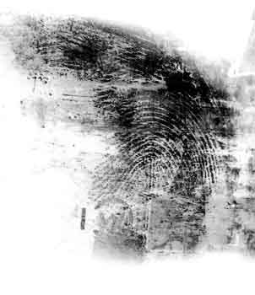
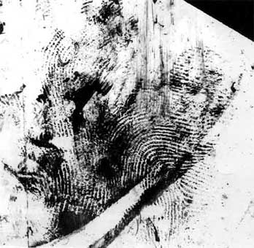
MMD – Silver and Gold
Wet Plastic Bag
Notes:
Rape case examined wet carrier bags recovered from the crime scene. Treated with MMD.

Slide 19
MMD – Cold Case 16 years old
Murder scene - August1988
Victim is found strangled and beaten with a leather belt near a public building in Bournemouth. An attempt had been made to set fire to the body. A number of coke cans and some other items were recovered from the scene.
Items were chemically treated in 1988 but no identifiable fingerprint impressions were recovered – examined by the Metropolitan police with Laser, UV scanning, Cyanoacrylate fuming, Rhodamine 6g and Gentian Violet.

Slide 20
In February 2005 MMD is used to examine items from the murder.
Two Fingerprints developed (tobacco tin and Beer Can)
Photographed and enhanced with the DCS-3
1 Fingerprint identified as the victim
1 fingerprint identified as the suspect
After 16 and a half years two previously unobserved marks were recovered.
Suspect charged and convicted

Slide 21
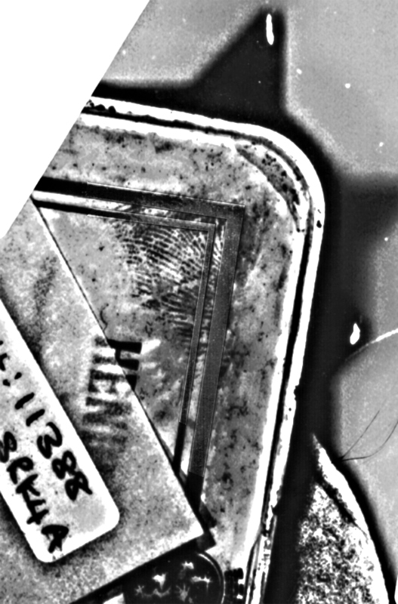
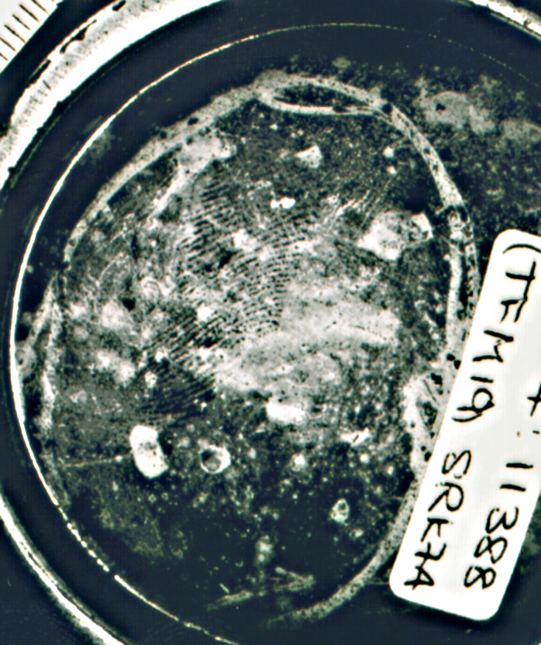
MMD – Cold Case 16 years old
Notes:
Difficult lighting, curved inward surface of beer can, also reflective and poor quality old mark. Goosenecks with cross polarising filters and yellow light for contrast.

Slide 22
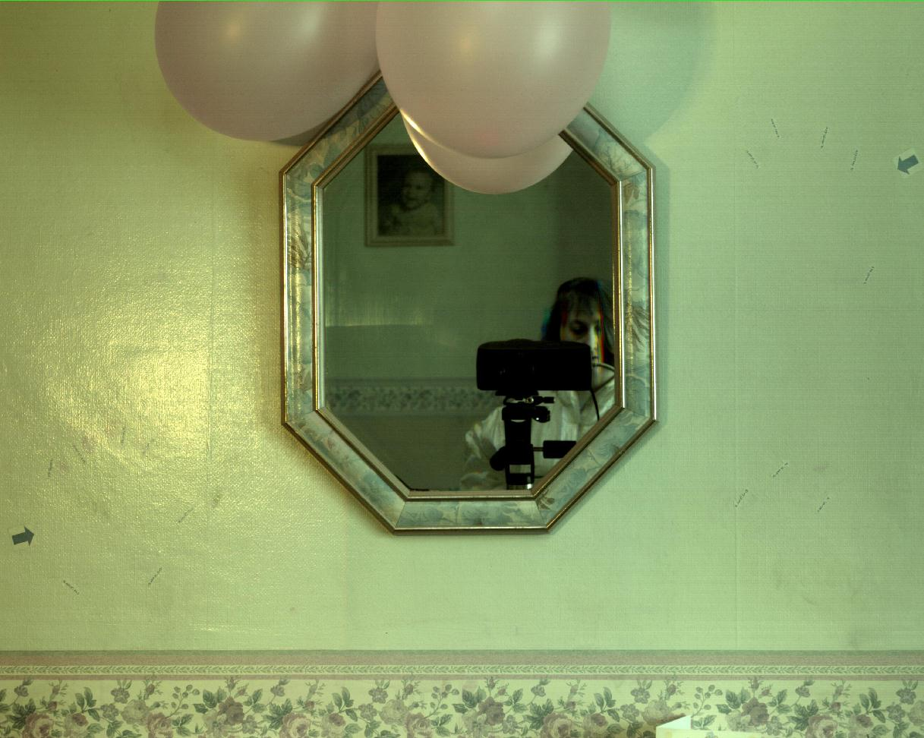
Murder 1998

Slide 23
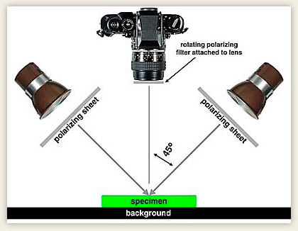
Cross Polarization is when illuminating light is polarized as well as the light entering the camera.

Slide 24
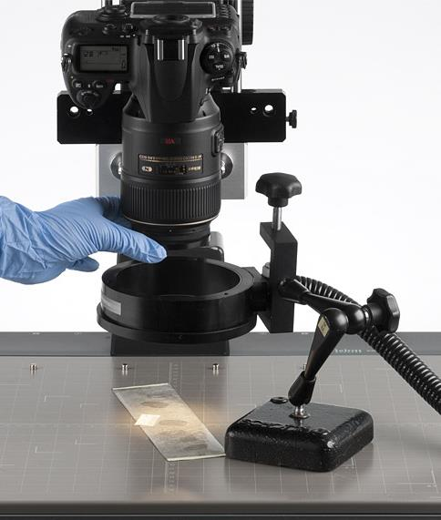
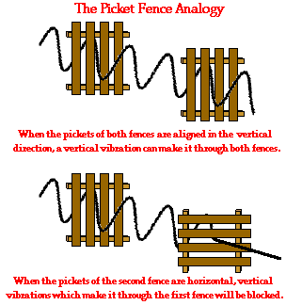
Cross Polarization is when illuminating light is polarized as well as the light entering the camera.

Slide 25
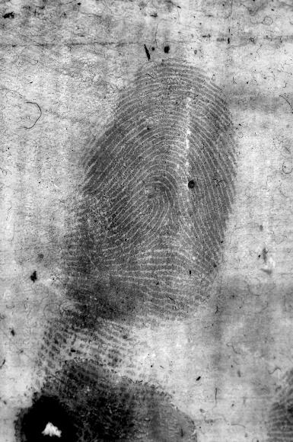
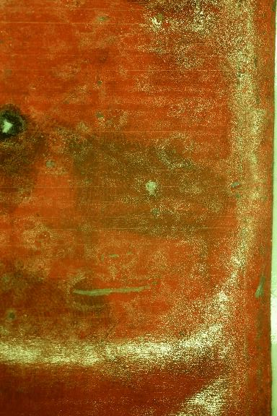
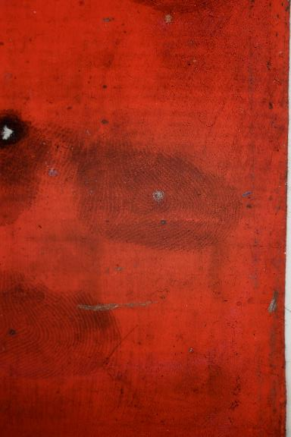

Slide 26
Murder 1998

Slide 27
China – Shenzhen 2009

Slide 28
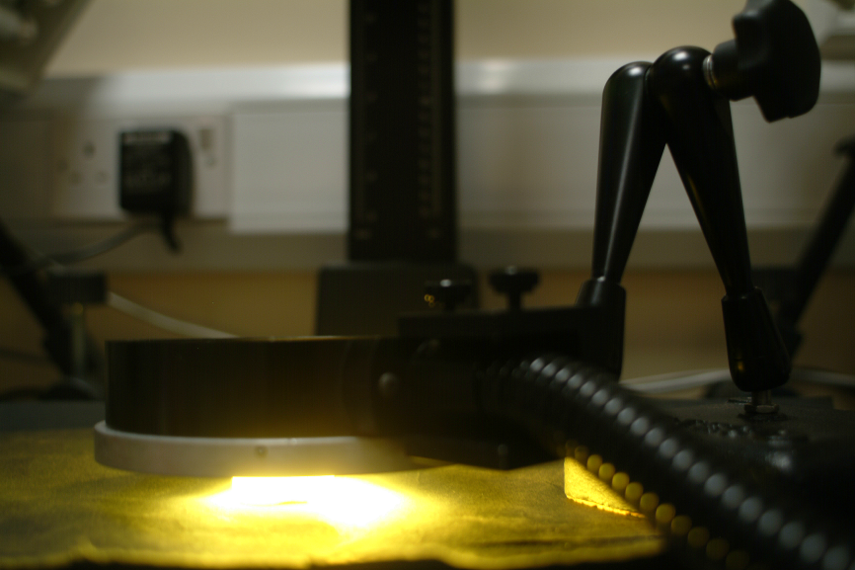
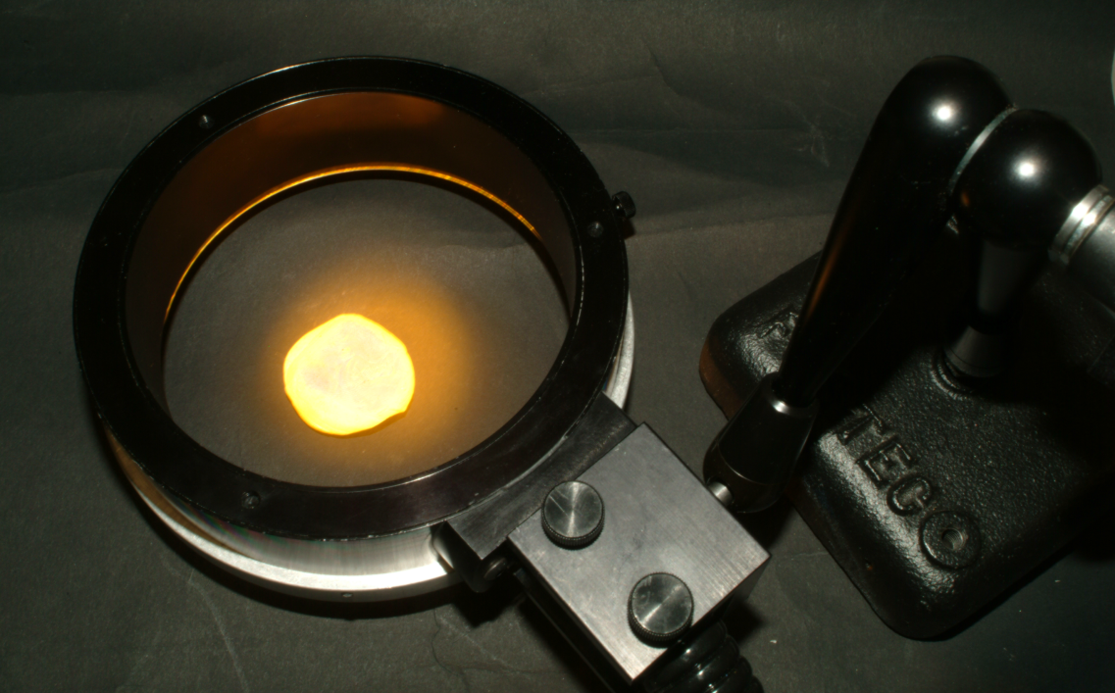
China – Shenzhen 2009
Highlight shadows in 3d fingerprints
Dark-field Ring-light

Slide 29
416nm – Darkfield Ring-light

Slide 30
416nm – Darkfield Ringlight

Slide 31
416nm – Darkfield Ringlight

Slide 32
Digital Imaging
Digital Image Enhancement

Slide 33
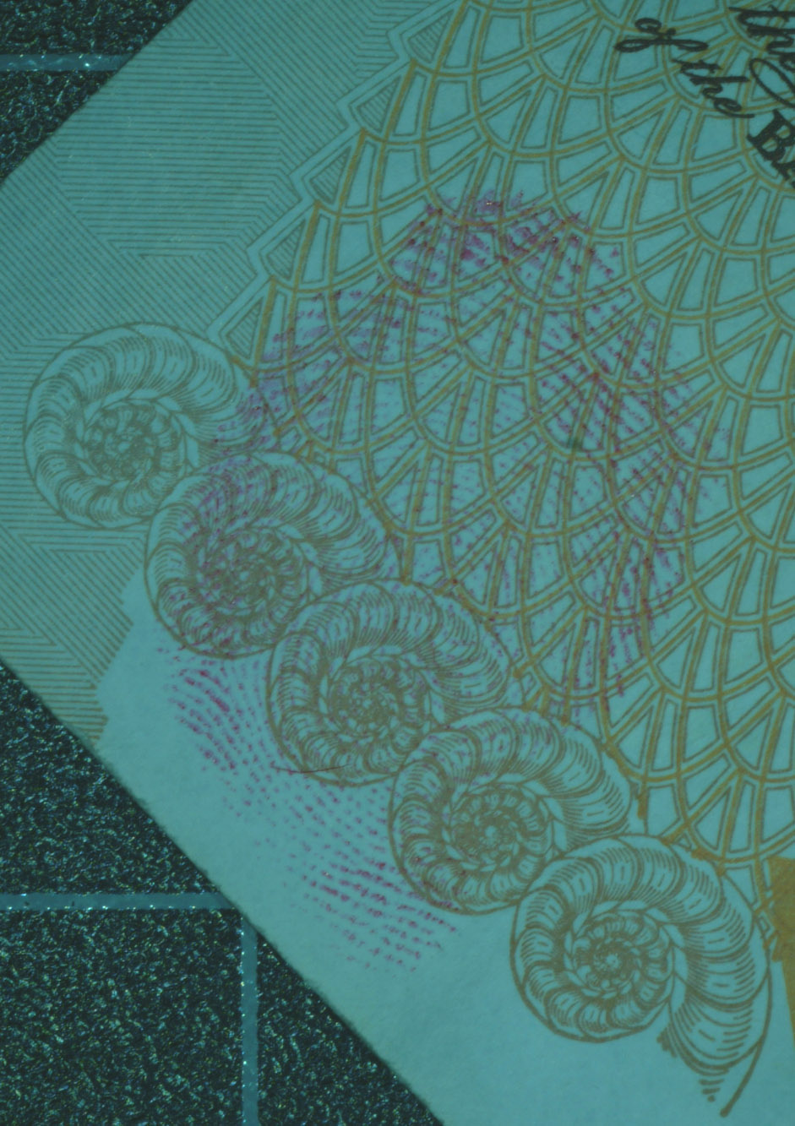
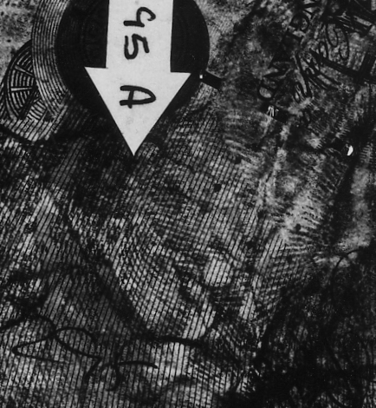
Problem Fingerprint Images
Attempted Robbery – ITC 1995 – FFT

Slide 34
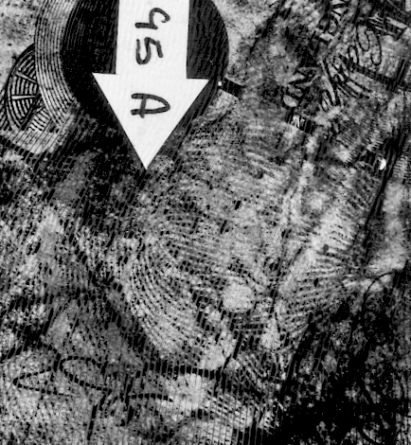
Fourier Transforms – Fast Fourier Transform - FFT
1995
2006

Slide 35
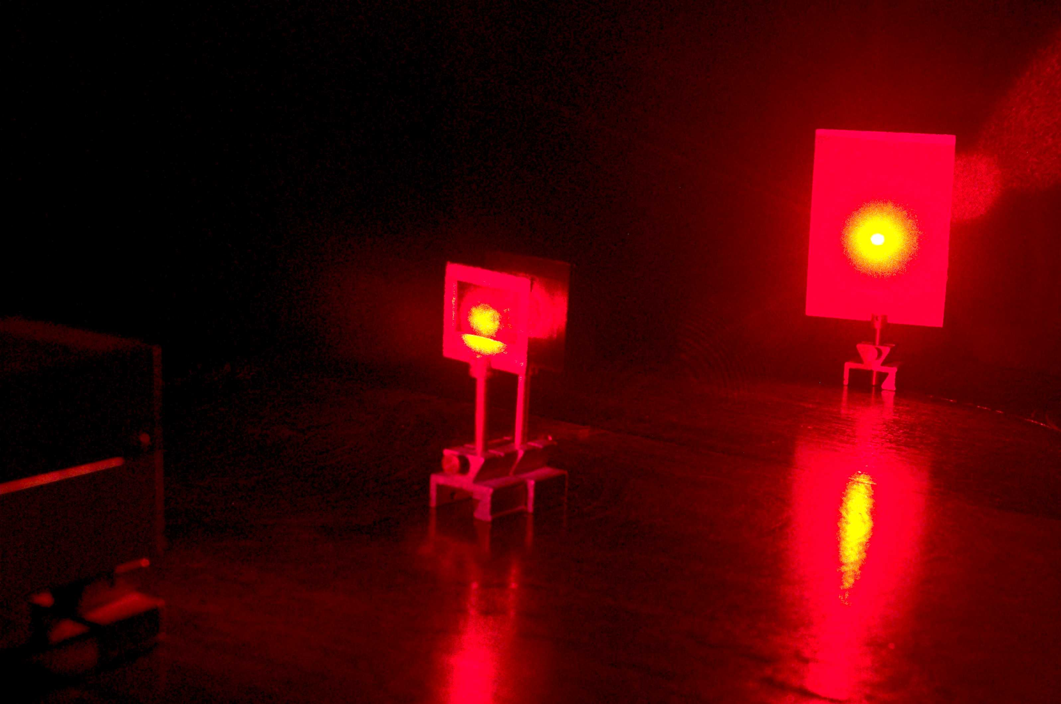
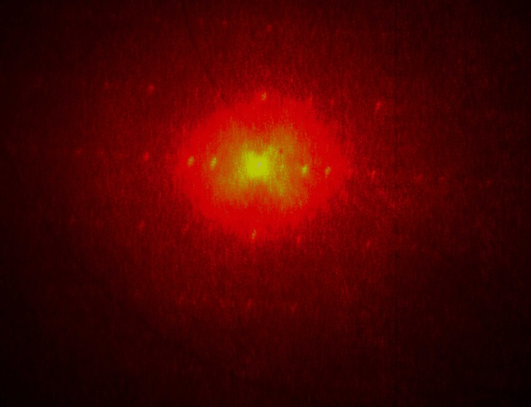
Fourier Transforms – Fast Fourier Transform - FFT

Slide 36
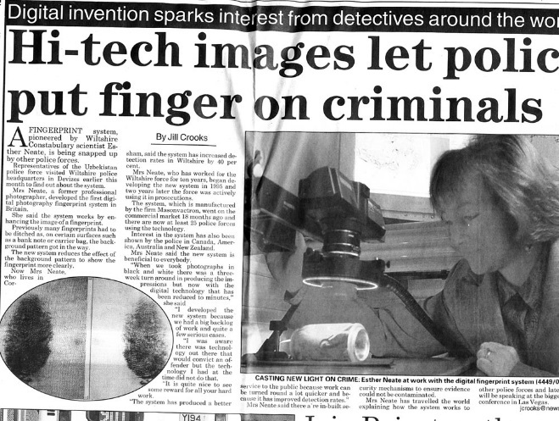
Fourier Transforms – Fast Fourier Transform - FFT
1978 – Video enhanced with FFT – Not accepted
1991 – Frye Hearing
1998 – featured in BBC Tomorrow’s World
Used today on thousands of cases worldwide.

Slide 37
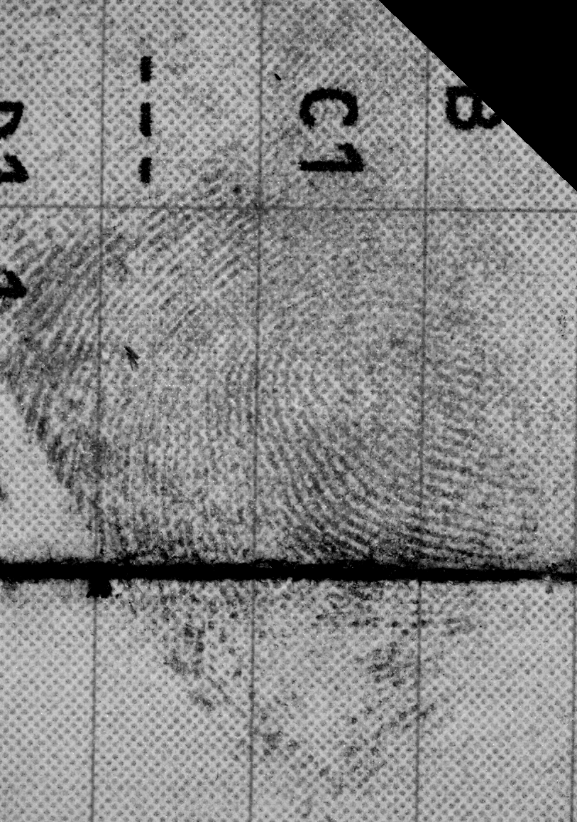
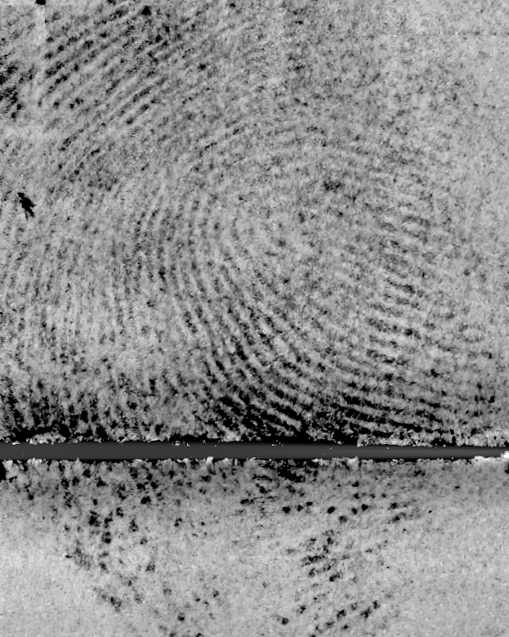
UK Paper Driving Licence - Ninhydrin

Slide 38
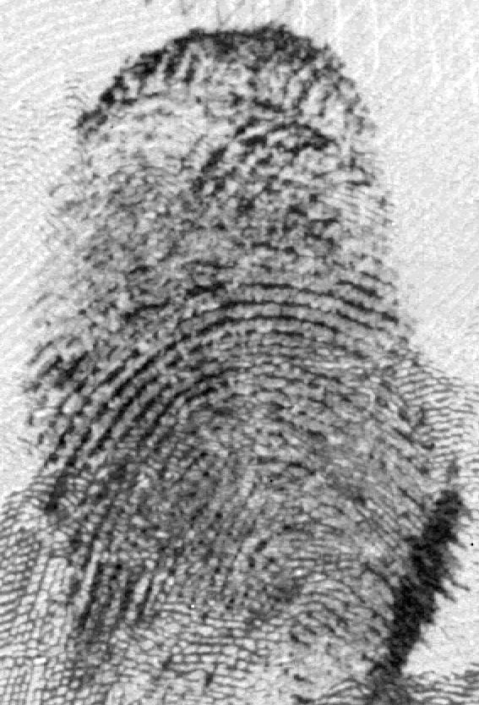
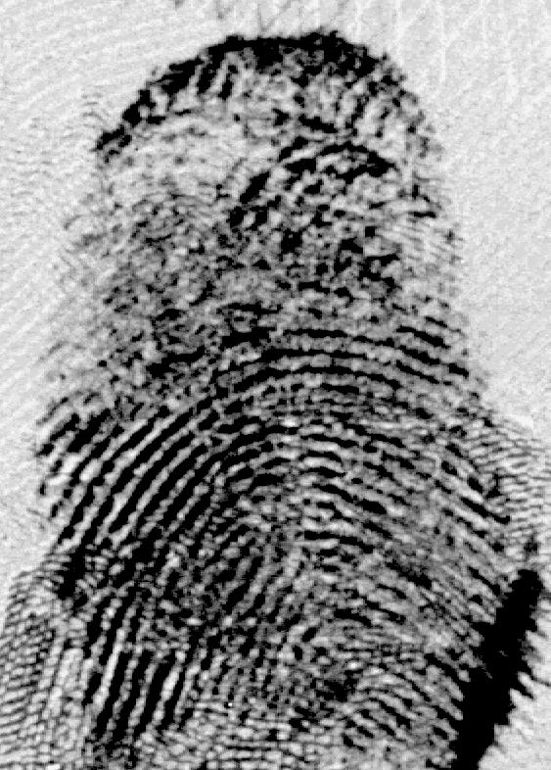
Boost wavelengths
Double Murder
Fingerprints in Blood
Developed with Coomassie Blue
FFT to boost the wavelengths
Fingerprints identified

Slide 39
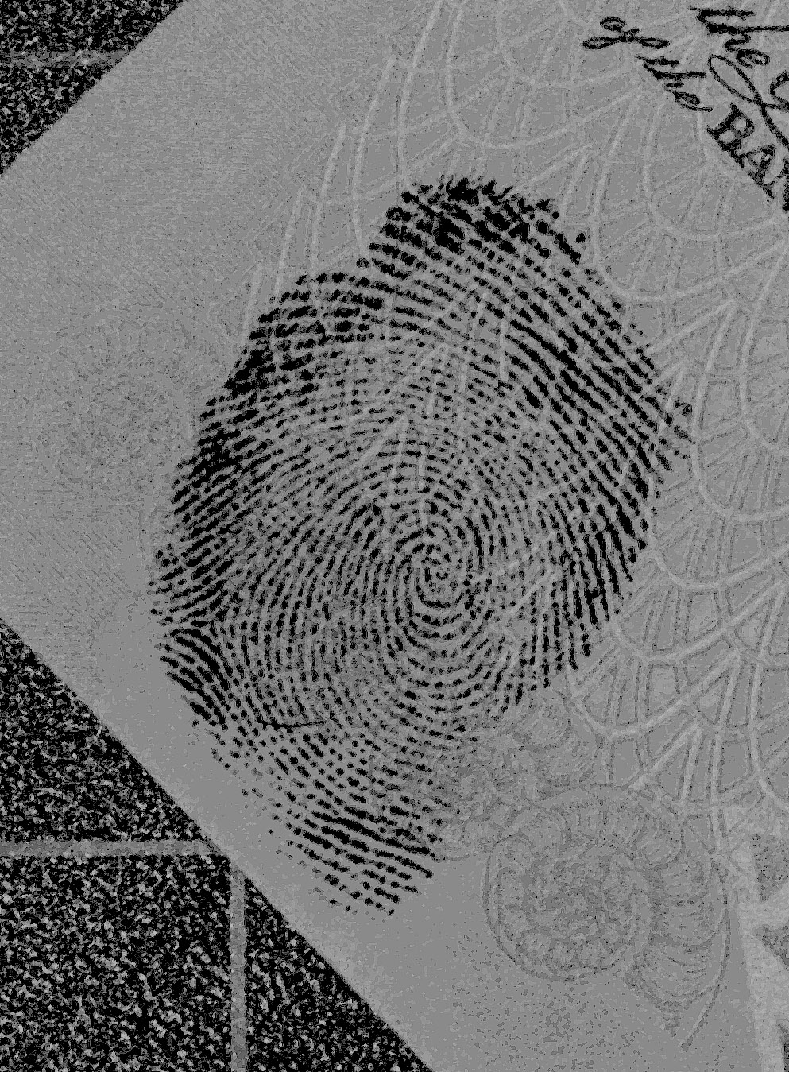
Colour Models

Slide 40
Colour Channels – Film Photography

Slide 41
Colour Models
RGB – HIS – HSV - YIQ

Slide 42
Colour Models

Slide 43
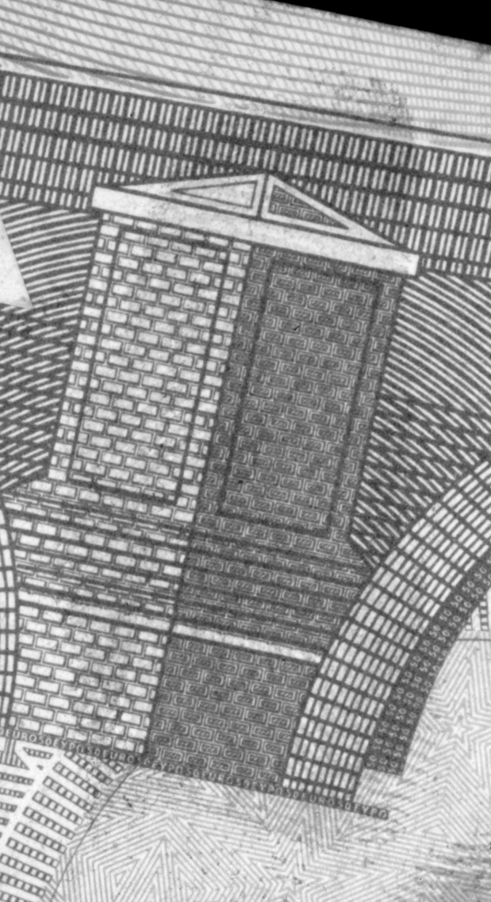
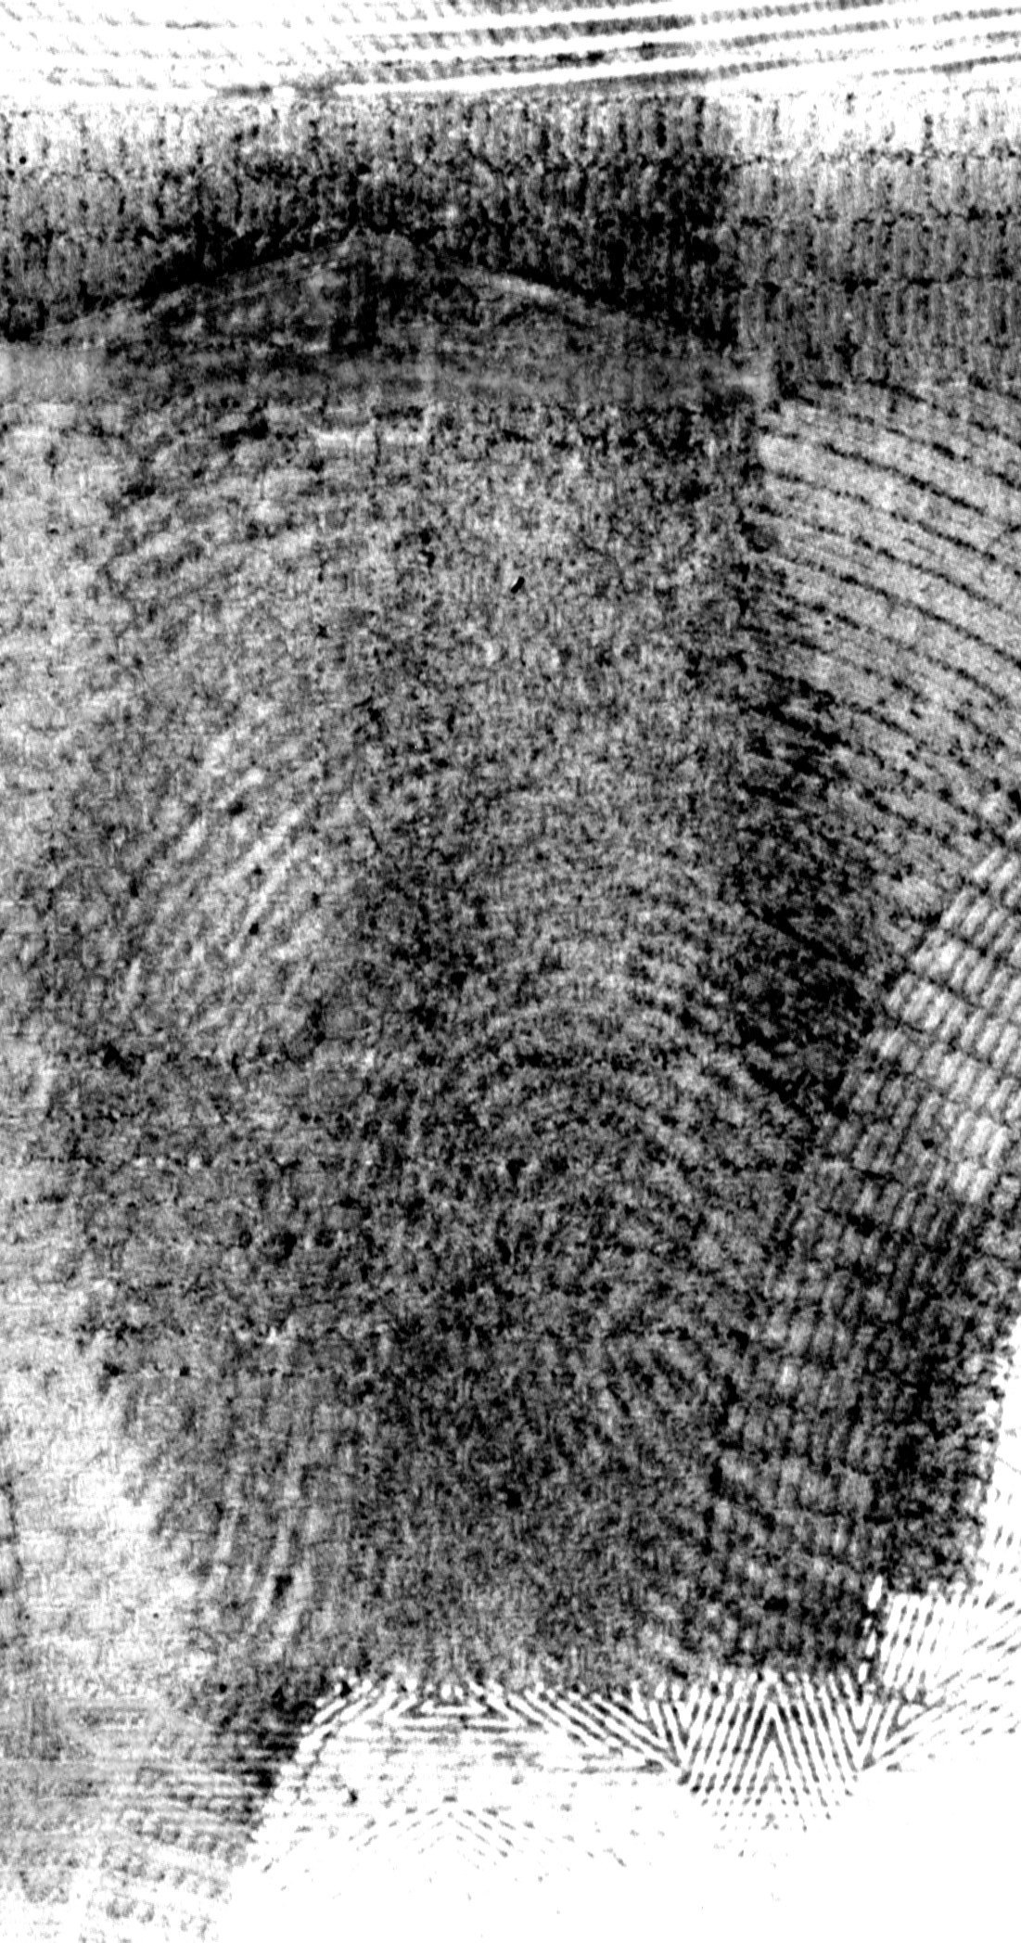
Colour Models

Slide 44
Senior Police Officers in Wiltshire were alarmed. Reports of a sharp rise in crack cocaine and heroin use led them to suspect that drugs gangs from Birmingham had infiltrated the quiet county. Undercover work by detectives posing as drugs users on the streets of Swindon led to a raid in which a stash of £20,000 in cash was found – but the fingerprints on the money were unclear against the background. It was impossible to match them to suspects.
Enter Esther Neate the Wiltshire Force's Senior Fingerprint Development Officer. Neate took digital photographs of the notes and using a computer program filtered out the background to reveal clear prints that helped jail Mosorof Ali, Iqbal Ahmed and Delroy Mcintosh for a total of 15 years
October 2004 – Enhanced with DCS-3 software using Colour modelling

Slide 45
foster+freeman
FORENSIC SCIENCE INNOVATION
For further information contact
Esther Neate
Esther@Neateimaging.com

